Slide 1


Imcgd214-Managing games production Imcgd111-Group project L4/5 GROUP 2
Jordan Marks
Alice Baker
Thomas Gibbs
Daniel Pokladek

Slide 2
The brief
Physics based game
Easy to learn game yet hard to master
J

Slide 3
Logline and target audience
Logline – Beat your Foes in this gravity based planetary arena.
Target audience - 18-35 Male and Female
Platform – Mobile
J

Slide 4
Game
What the player does
Physics in the game
Turn based game play
TD

Slide 5
Prototype
TD

Slide 6
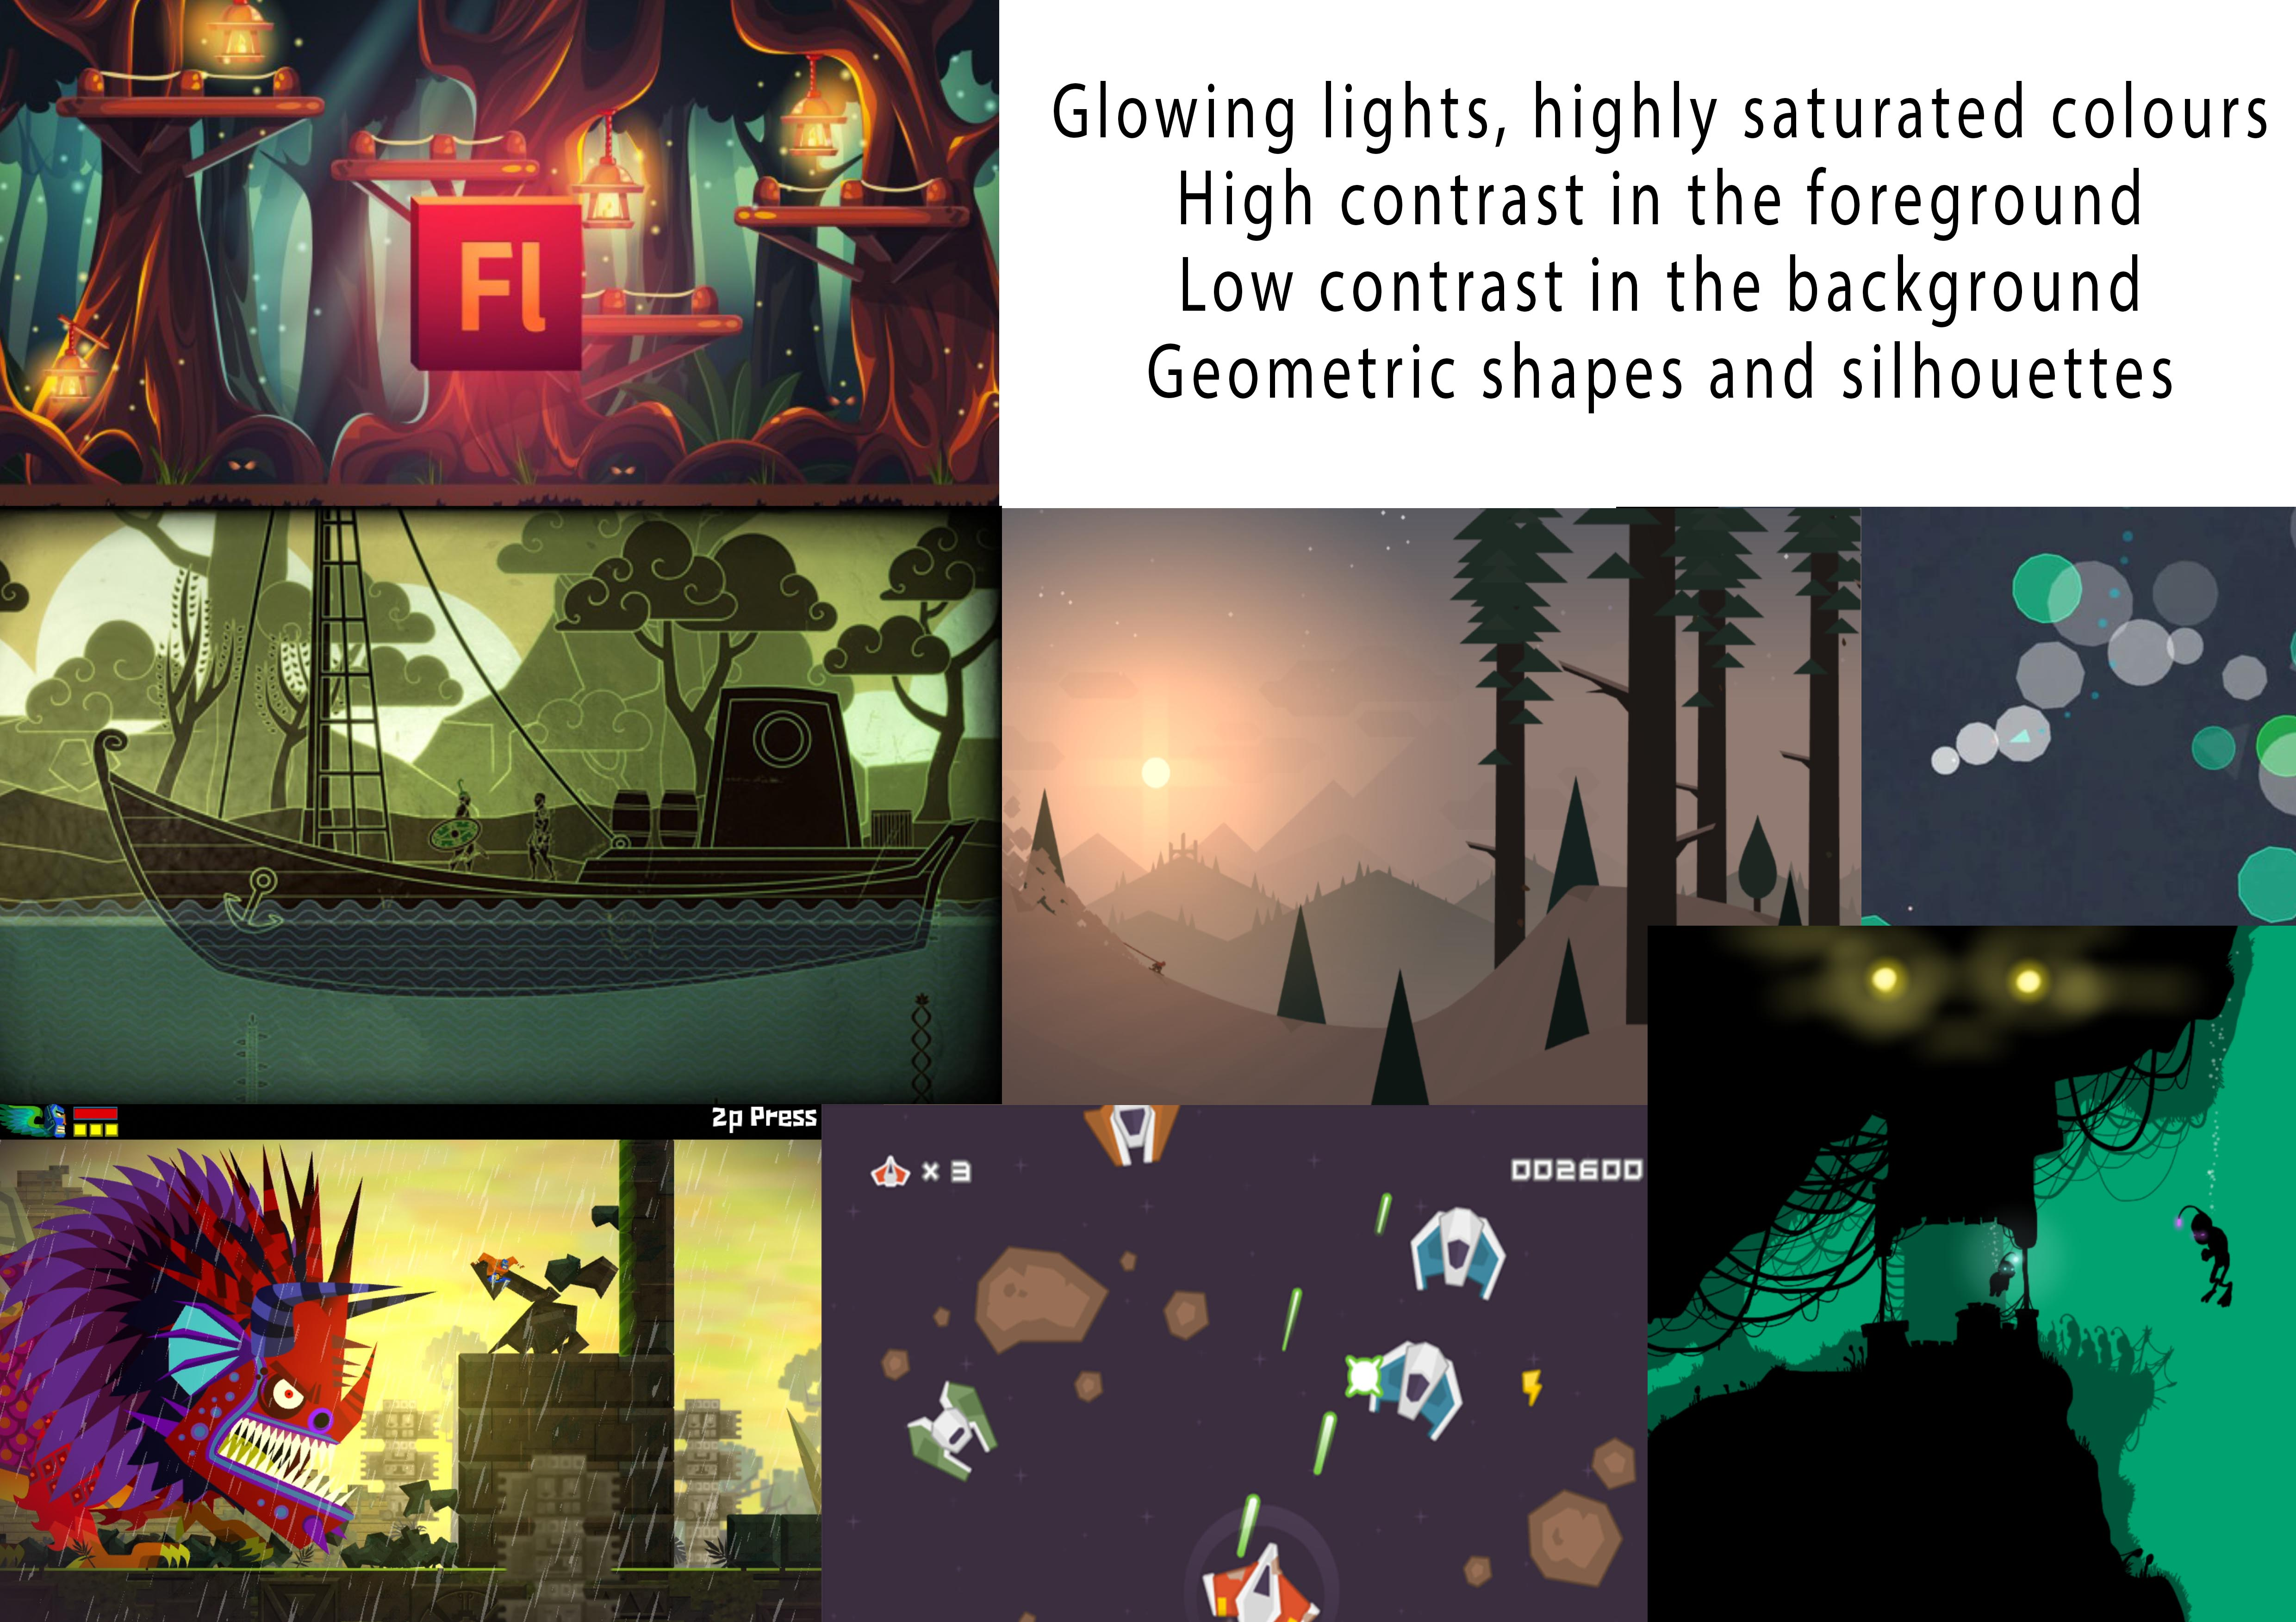



Art style and Moodboard
A

Slide 7


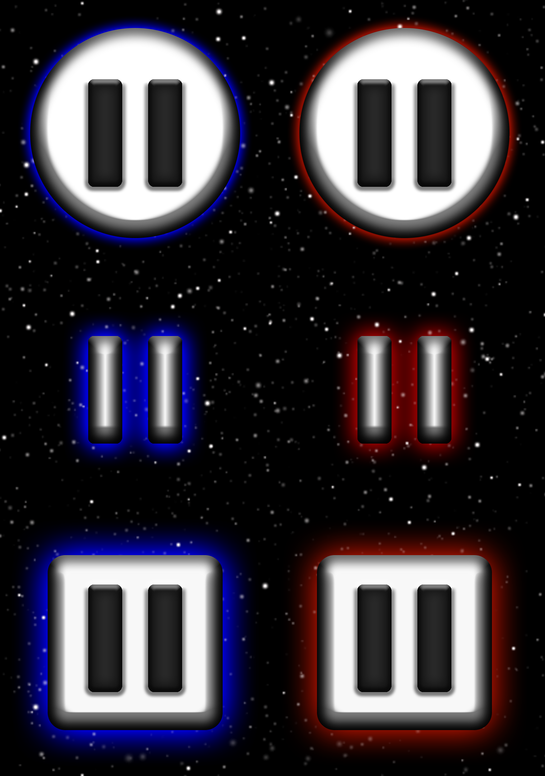
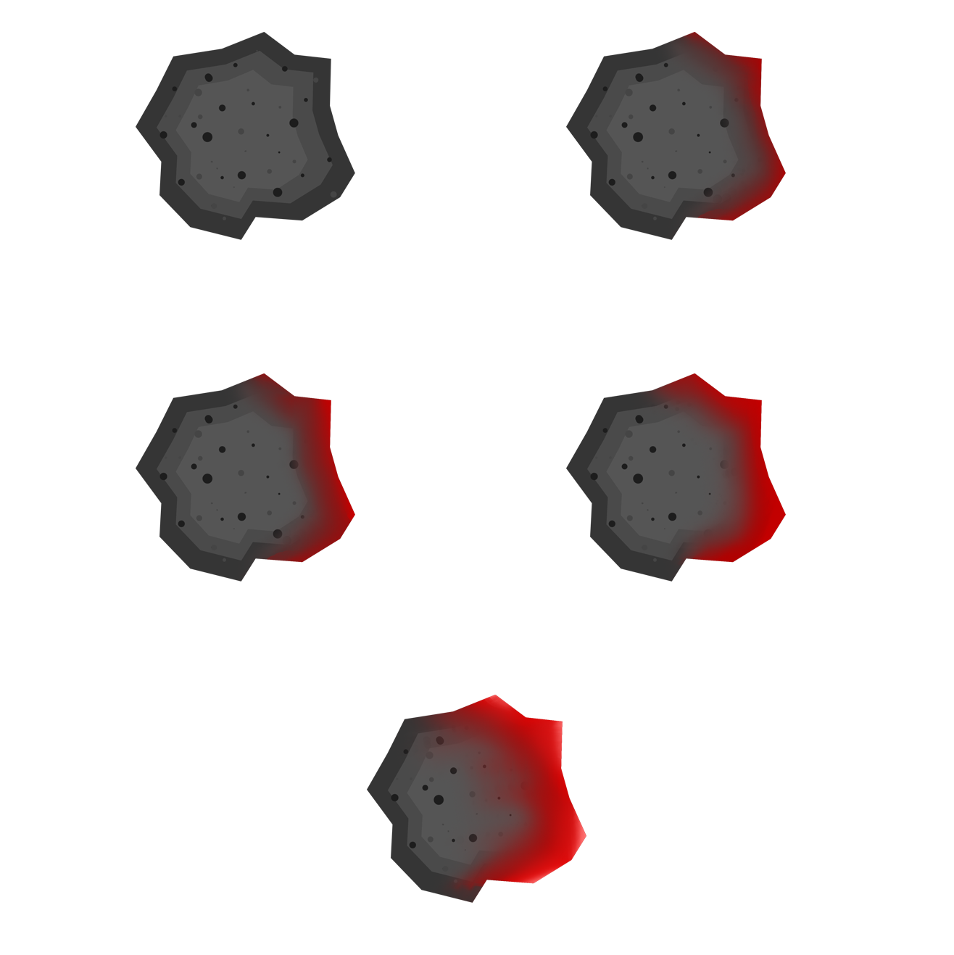










Game art
A

Slide 8
management

Slide 9
Questions?

